Slide 1
Canadian Illicit Cannabis Market
November 2019
Jacob Miller (jacob.miller@canada.ca)
Office of Drug Research and Surveillance
Controlled Substances and Cannabis Branch
Health Canada

Slide 2
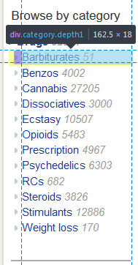
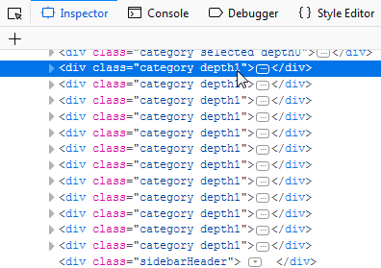
Scraping
The general concept of scraping is to look at the HTML code of the web page and look for patterns in the way the data is stored.
In the example below, you can see that each of the category links is held in a div class named “category depth1”. This can be used to loop through each of these specific sections.

Slide 3
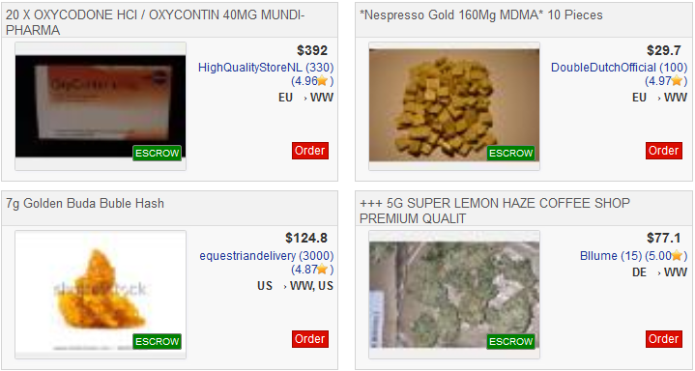
Creating a database from a dark web market pages
Any dark web market will have a database of their listings. There is no way to access the source database, but it can be reverse-engineered.
Listing title | Price | Seller | Ships from | Ships to
20 X OXYCODONE HCI / OXYCONTIN 40MG MUNDI-PHARMA | $392 | A | EU | WW
*Nespresso Gold 160Mg MDMA* 10 Pieces | $29.70 | B | EU | WW
7g Golden Buda Buble Hash | $124.80 | C | US | WW, US
+++ 5G SUPER LEMON HAZE COFFEE SHOP PREMIUM QUALIT | $77.1 | D | DE | WW
Notes:
Basically, the people running Dream Market create the website by saying “for each row in our database of listings, create a little box. The listing title variable goes here at the top, the price goes here, etc”. They just need to ‘design’ one box, and then they can loop through their database with the same logic for all 80,000 listings.
To re-create the database from the web page, I just create a process that loops through each box in the page, and creates a new row in my database where the title field gets its data from the appropriate HTML field, same for the price and so on. Just like them, I just need to write out the logic for one box, and then loop through the rest of them.

Slide 4
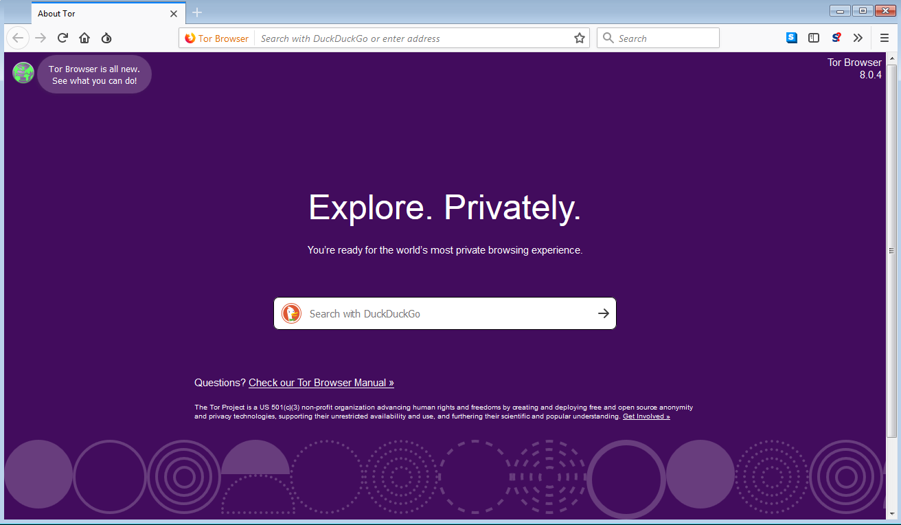
The dark web - Tor
The dark web is a portion of the internet that requires specific software (i.e. Tor) to access.
Tor routes the data coming to and from the user through several relays, which are run by the community.
Otherwise, it functions as a normal browser.

Slide 5
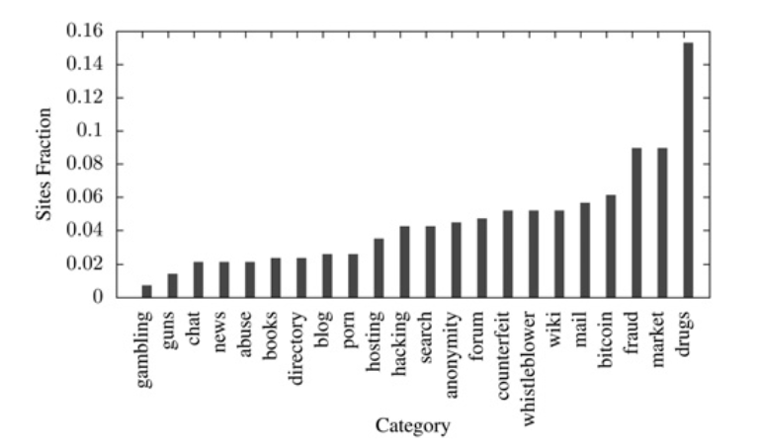
Breakdown of Tor sites
Owen, G., & Savage, N. (2016). Empirical analysis of Tor Hidden Services. IET Information Security, 10(3), 113–118. https://doi.org/10.1049/iet-ifs.2015.0121

Slide 6
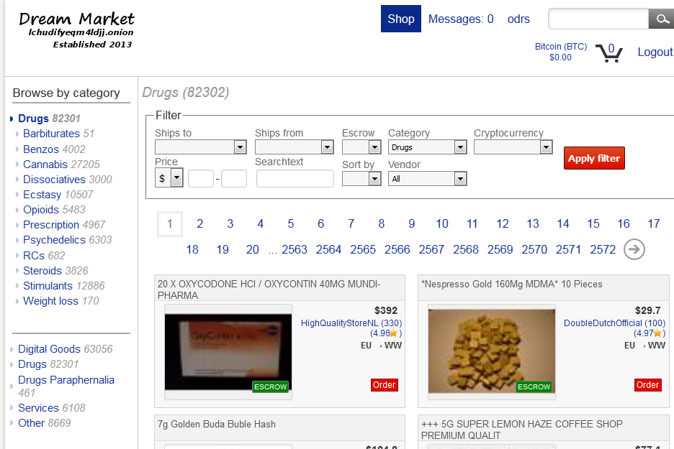
Drugs on the dark web
Notes:
As the previous slide showed, drugs are the largest category on the dark web. This is the Dream Market, the largest operating market on the dark web. The website operates as a host for users to sell drugs from consumer to consumer. Anyone can make a listing or purchase. Although they sell other things, drugs are their largest category with over 80,000 listings. For our purposes, they are essentially the ebay of drugs.

Slide 7
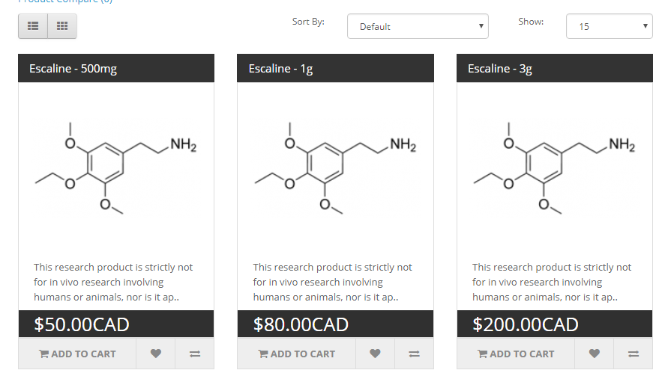
Open web research chemical example
As opposed to ebay-style consumer-to-consumer markets found on the dark web, open web drug sellers sell direct to consumer by selling legal drugs that have a psychoactive effect.
Notes:
As opposed to ebay-style consumer-to-consumer markets that are found on the dark web, what we find on the open web are business-to-consumer models. This makes it much easier to scrape the data, as it means that there will be one listing per drug, as opposed to thousands of listings just for different people selling meth.
Scraping the open web is essentially the same process. So far, ReChem has been scraped, as I’ve seen it as the most commonly mentioned supplier on research chemical discussion forums.

Slide 8
Future plans
The next step will be to thoroughly map out the websites we are interested in scraping and begin expanding our data sources.
A single database with cleaned data from several markets (dark web and legal) provide valuable and convenient information that has previously been obfuscated.
Additionally, creating better scrapers that can function more reliably will allow for them to be run on an automated interval. This will add a time component to the data and allow us to track trends (prices, drug availability) over time.
There is also the possibility to scrape larger amounts of data from user discussion forums and analyse/categorize it using natural language processing.

Slide 9
Limitations
You can’t get sales data, which means you can find the average list price, but not the average sale price.
If you have 5 listings of meth ranging from $7-11 per gram, you can say that the average sale price is $9. However, since you don’t know how many sales were made on each of the listings, you can’t say what the actual average sale price of meth is.
Maintenance cost. It is feasible to scrape the data of each drug market website, but creating and maintaining code to scrape them continually over time is much more difficult. Any changes in website schema must be reflected in the scraper.

Slide 10
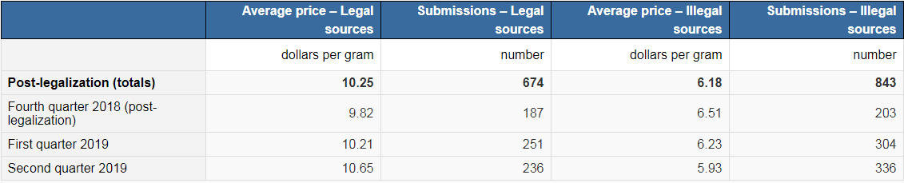
Illicit Cannabis Potential Sources
CCS:
From a friend (34%)
From a compassion club/dispensary (15%)
Shared among friends (13%)
From a dealer (7%)
Grown by or for them (7%)
From an acquaintance (7%)
Statscan crowdsourcing:
Dark web:
“We looked into patterns of sales at two points in 2018, prior to cannabis legalization (July 2018), and after (November 2018)… The volume of cannabis shipped appears to have also increased over the same period, rising from hundreds of kilograms to perhaps as much as 2,229 kilograms per year for the most optimistic model” (Décary-Hétu, 2019)
Open web:
No source?

Slide 11
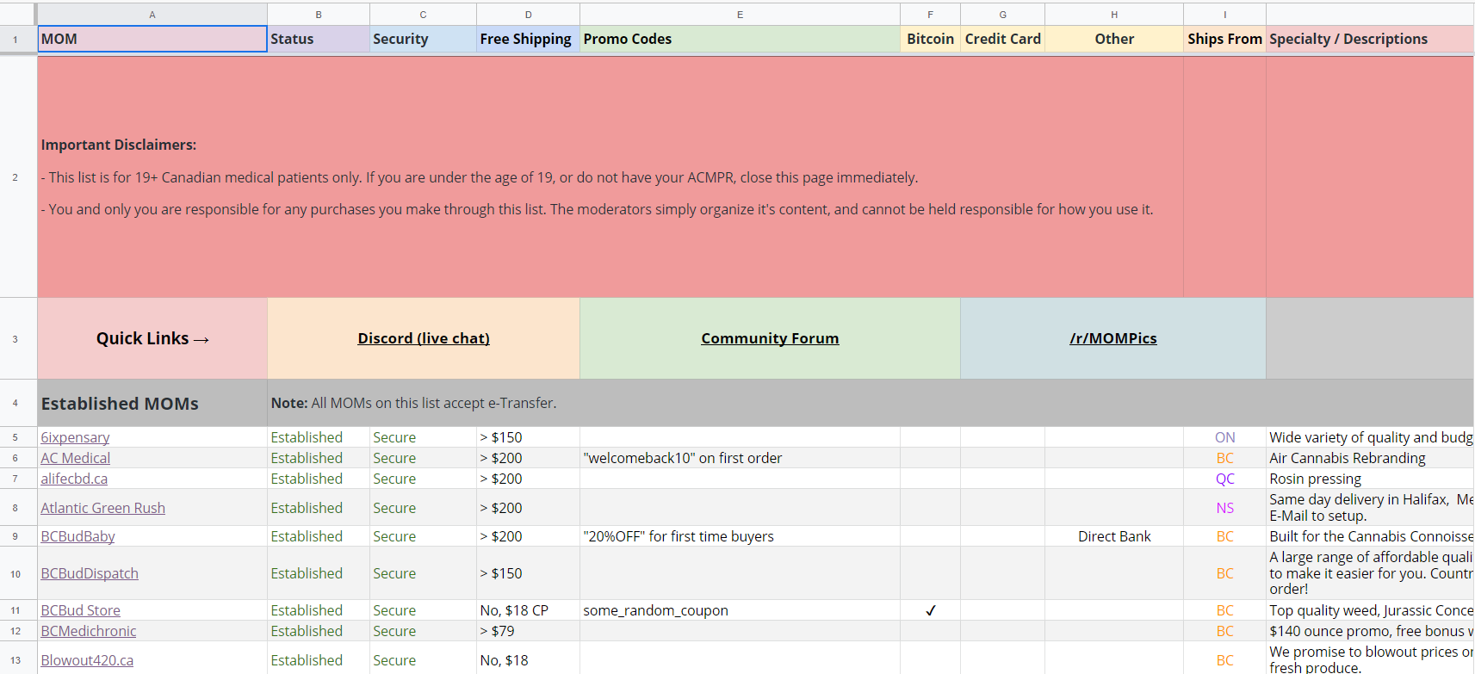
Canadian Mail Order Marijuana websites
300+ Canadian websites selling marijuana online

Slide 12
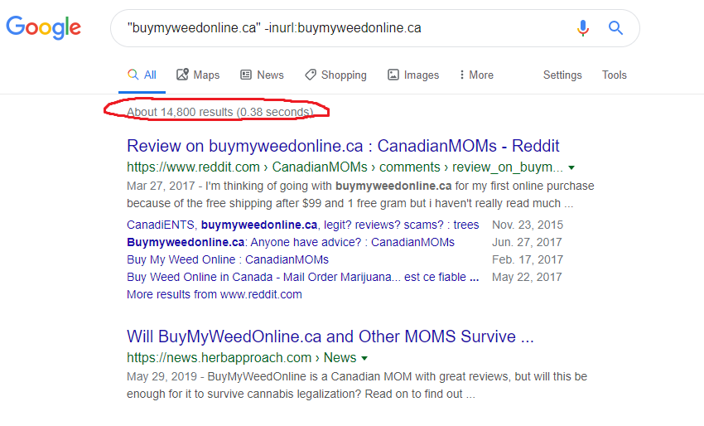
Finding the most popular sites

Slide 13
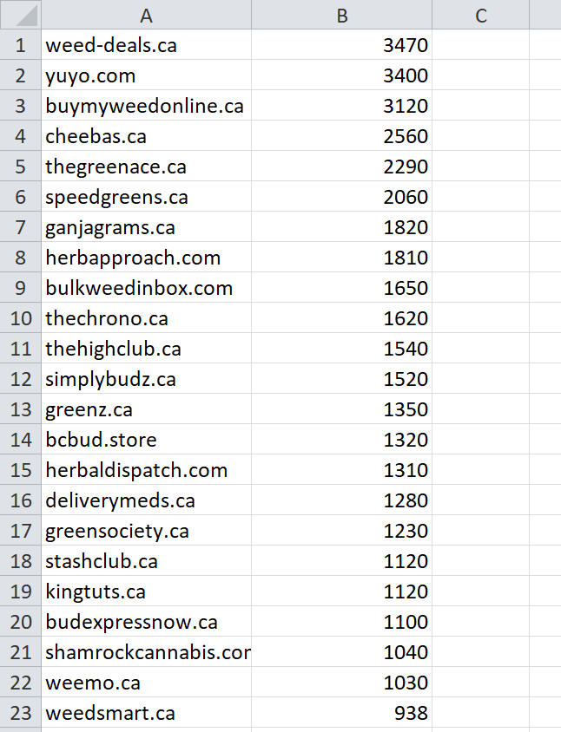
Finding the most popular sites

Slide 14
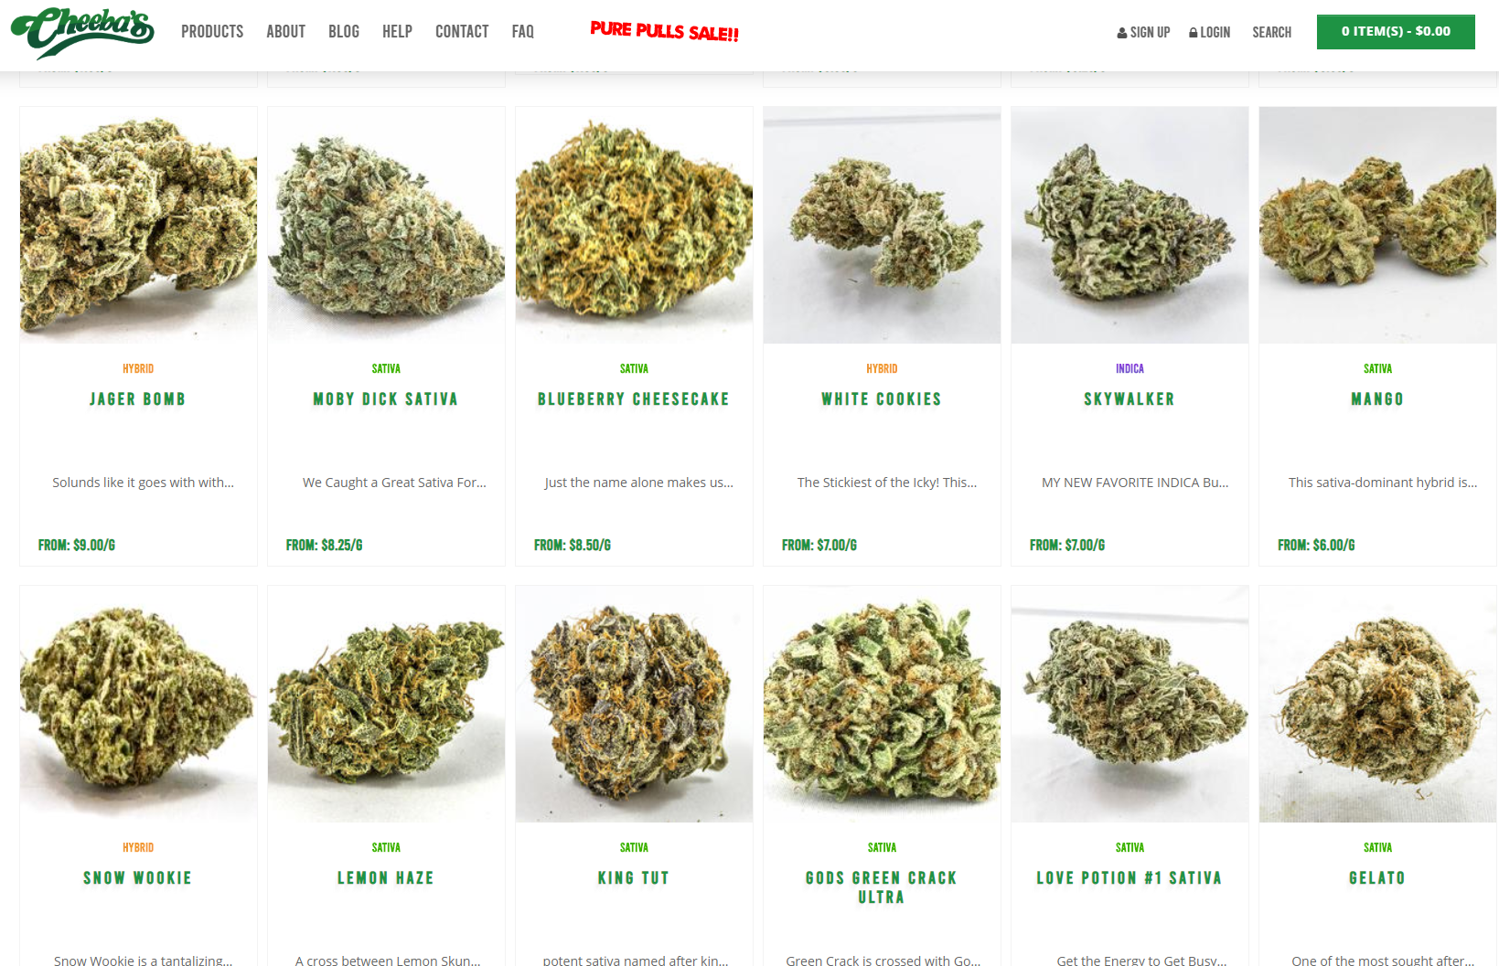
Scraping

Slide 15
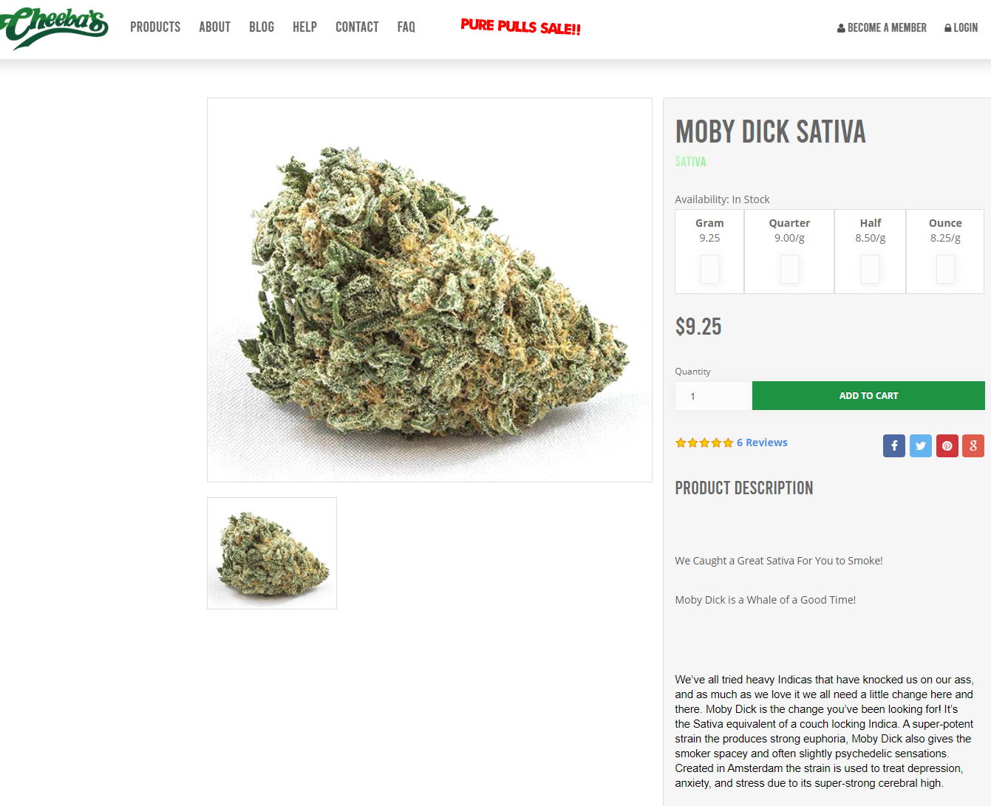
Scraping

Slide 16
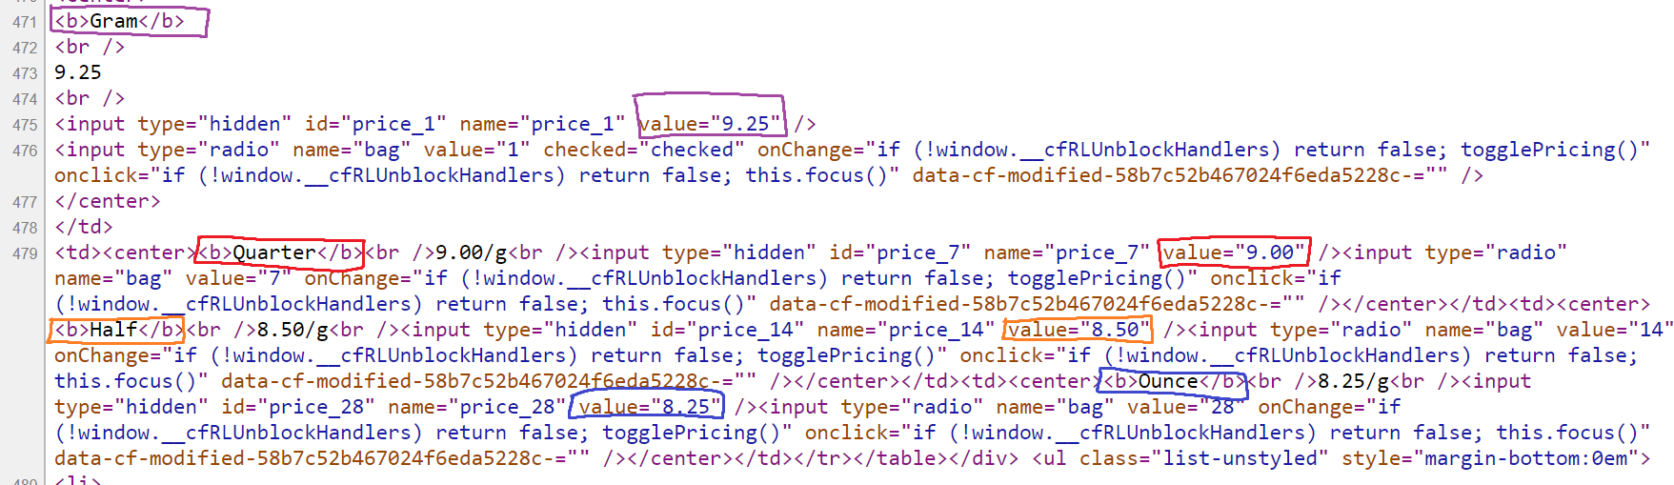
Data extraction

